Slide 1
Newness
Year 12 Religious Education

Slide 2
We pray in the name of God
In the name of the Father
And of the Son
And of the Holy Spirit
Amen

Slide 3
Welcome
The Lord makes all things new.
In this new class of Religious Education help us to open our minds to the world and to the actions and beliefs of one another.
God of light, by whose Spirit all things are made new, we praise you for the gift of life, for the blessing of a new season, for the mercy that makes each day a fresh start.
All: Grant us the strength to walk in your light, the grace to experience your presence with us, and the hope that comes from being made new in Christ. Open our eyes, our ears and our hearts. In Jesus name we pray.
Amen.

Slide 5
Scripture reading
A reading from the Book of Revelation 21:3-5
Now the dwelling of God is with people, and he will live with them. They will be his people and God himself will be with them and be their God. He will wipe every tear from their eyes. There will be no more death or mourning or crying or pain, for the old order of things has passed away. He who was seated on the throne said, “I am making everything new!” Then he said, “Write this down, for these words are trustworthy and true.”
This is the word of the Lord
All: Thanks be to go

Slide 7
Reflection on the reading
God promised to make all things new again. It's a constant promise made by God, from the lips of Isaiah to the triumphant cry of Christ risen from the dead: "Behold, I make all things new."
The ability to make things new again, even better than the original creation, is a prerogative of God. God Himself is ever new—He never ages for He is eternal. Moreover, because He is infinite, we will never cease seeing new insights of his beauty and magnificence; for all eternity we will never be bored.
When we say that God is ageless, unchanging, this is not to say that He lacks life, but rather, that He is so alive that He does not lose any of his perfection, but is always new.
We walk in newness of life…destined to sing a new song of praise to God forevermore.

Slide 8
Meditation: What is the newness I seek?
What do I hope for?
For myself?
For others I know personally?
For the various groups to which I belong?
For others I don’t know personally?
For the planet in which I have emerged into life?

Slide 9
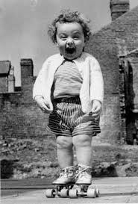
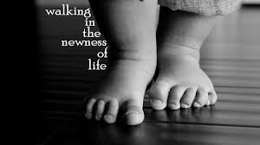
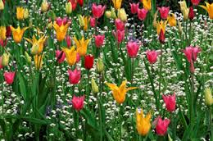
Reflection

Slide 10
Community Prayers
Leader: We trust in God, who makes all things new. Let us lift up to him our prayers, saying:
All: Lord, you make all things new.
Leader: For those who feel they are out of second chances, fill them with hope in you.
All: Lord, you make all things new.
Leader: For those who are broken and seeking the truth, guide them to the fullness of faith in you.
All: Lord, you make all things new.
Leader: For children, parents, and schools, keep them always in the care of your redeeming love.
All: Lord, you make all things new.
Personal intentions

Slide 11
Conclusion
We make our prayers in the name Jesus the Christ who came to make all things new in the Spirit and by the power of the one he called Father. Open our eyes, Lord

Slide 12
Open My Eyes Lord
https://www.youtube.com/watch?v=eo6gZAUuQ3E

